Slide 1
E-retail factors for customer activation and retention: A case study from Indian e-commerce customers
Houses are one of the necessary need of each and every person around the globe and therefore housing and real estate market is one of the markets which is one of the major contributors in the world’s economy.
It is a very large market and there are various companies working in the domain.
Data science comes as a very important tool to solve problems in the domain to help the companies increase their overall revenue, profits, improving their marketing strategies and focusing on changing trends in house sales and purchases. Predictive modelling, Market mix modelling, recommendation systems are some of the machine learning techniques used for achieving the business goals for housing companies.
Our problem is related to one such housing company.

Slide 2
Problem Statement:
A US-based housing company named Surprise Housing has decided to enter the Australian market.
The company uses data analytics to purchase houses at a price below their actual values and flip them at a higher price. For the same purpose, the company has collected a data set from the sale of houses in Australia.
The data is provided in the CSV file.
The company is looking at prospective properties to buy houses to enter the market.
We are required to build a model using Machine Learning in order to predict the actual value of the prospective properties and decide whether to invest in them or not.
The company wants to know:
Which variables are important to predict the price of variable?
How do these variables describe the price of the house?

Slide 3
Understanding:
There are 2 excel sheets that have been shared.
First, excel sheet is the detailed data of the houses along with all the features and prices.
Second, excel sheet is the list of all the houses and we need to predict the prices of the houses.
There are information of houses which have certain features and build structures on which the price of the house might depend.
The features can be relevant or irrelevant for the pricing of house.
We need to find the relevance of the features in predicting the price of the house.

Slide 4
Business Goals
We are required to model the price of houses with the available independent variables.
This model will then be used by the management to understand how exactly the prices vary with the variables. They can accordingly manipulate the strategy of the firm and concentrate on areas that will yield high returns.
Further, the model will be a good way for the management to understand the pricing dynamics of a new market

Slide 5
Data Inspection
**df**
Range Index: 1460 entries each having 81 variables
Data columns (total 81 columns): float64(3), int64(35), object(43)
There are no duplicated records
The data contains null values which would be filled using mean, median and mode.

Slide 6
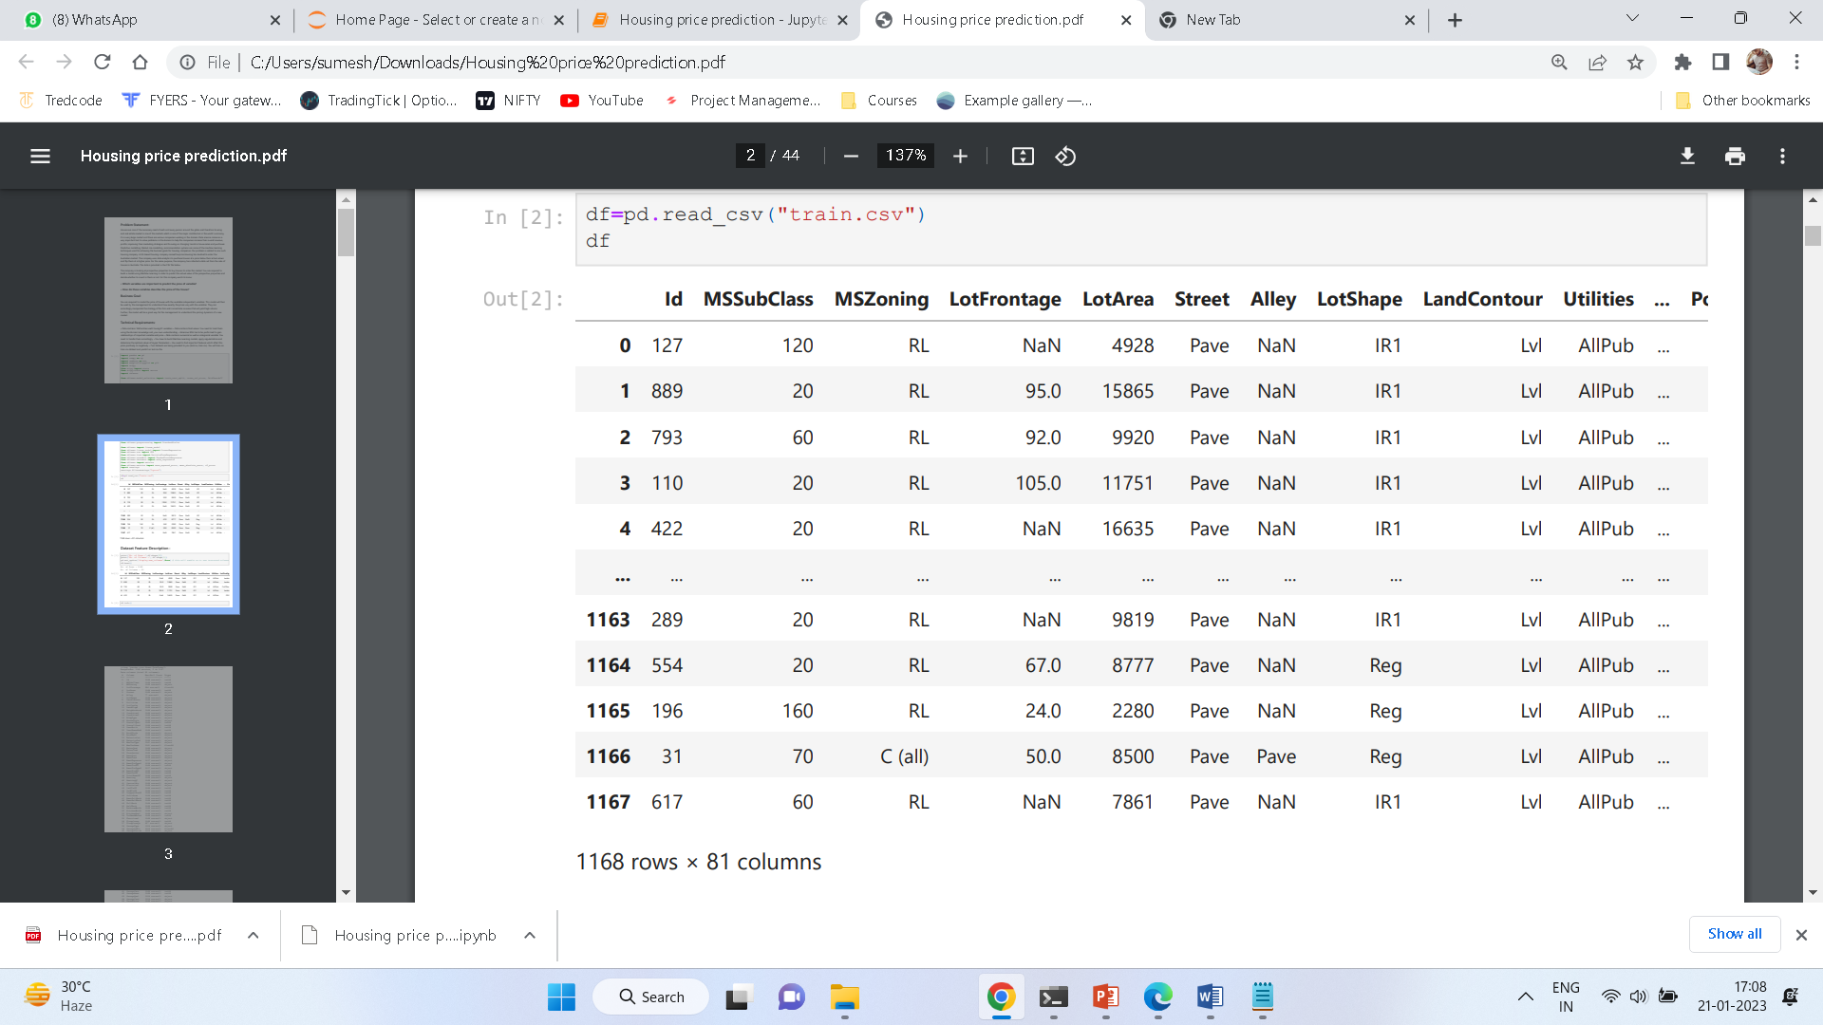
Descriptive Statistic:
First Dataset:

Slide 7
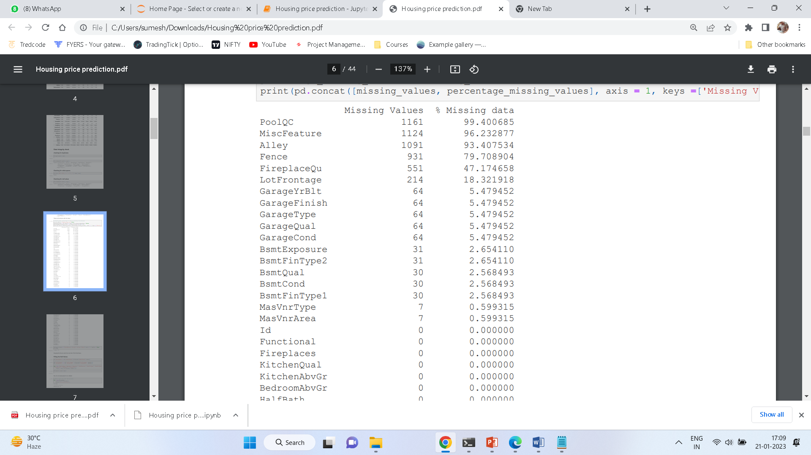
Handling null values:
The columns :
PoolQC
MiscFeature
Alley
Fence
have been deleted from the data frame as they contain more than 80% of null data

Slide 8
Feature Selection(Removal of columns)
'MiscFeature','PoolQC','Alley','Fence‘ – dropped due to high number of null values.
Utilities – Dropped as has only one unique value in the column.
Id – Dropped, as logically it has no contribution in output.
'TotRmsAbvGrd','GarageArea','TotalBsmtSF','Exterior2nd – Dropped as correlation factor was very high for these columns and would have led to overtraining.

Slide 9
EDA
Exploratory Data Analysis

Slide 10
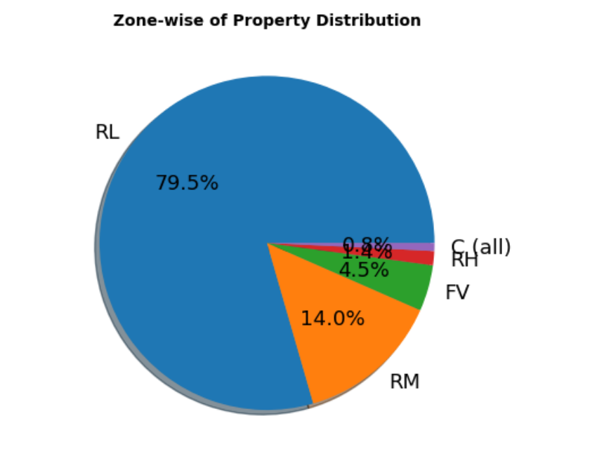
1. 79.5% of House properties belongs to Low Density Residential Area followed by 14 % of properties belong to Medium Density Residential Area. 2. Very Few property (0.8%) belongs to Commercial zone.

Slide 11
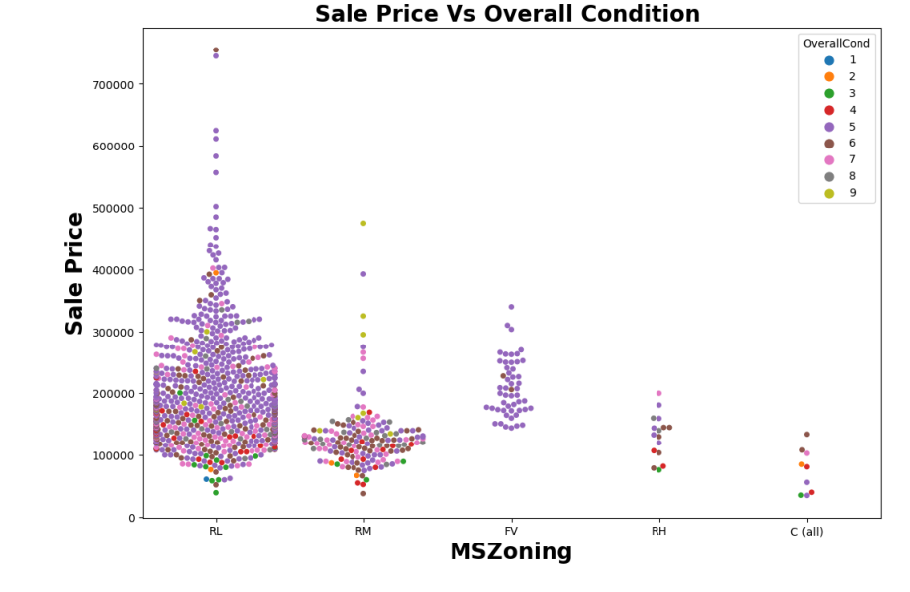

Slide 12
Sale Price Vs Overall Condition based on zones
Most of property for sale have overall condition rating of either 5 or 6.
Sale Price inside RL Zone is much higher than other remaining zone.
Cheapest properties are available in Commerical zone.
Another interesting observation we get here is for some house properties having Overall condition Rating of 8 & 9 have low price compare to others.
This indicate that Overall Condition Rating is Not significant factor in determination of Sale price. Overall Condition Rating may helpful to buyer in taking decision of Buying property but not in determination of House Price.

Slide 13
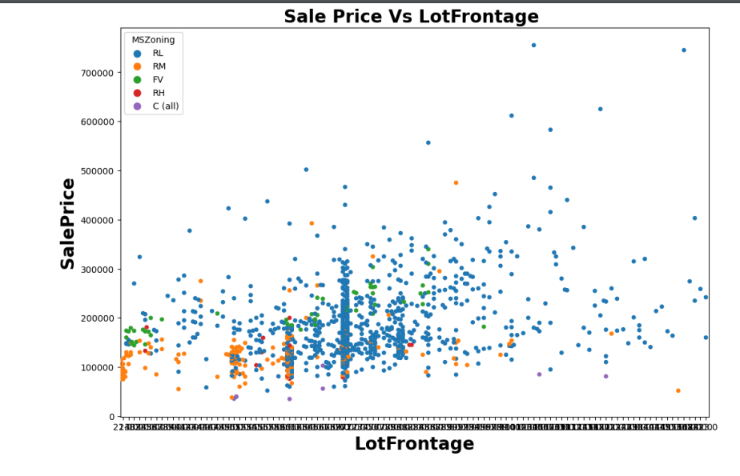
With Exception of Commercial zone, As Lot Frontage area increase (which indicate Size of street connected to property) the Sale Price increases.

Slide 14
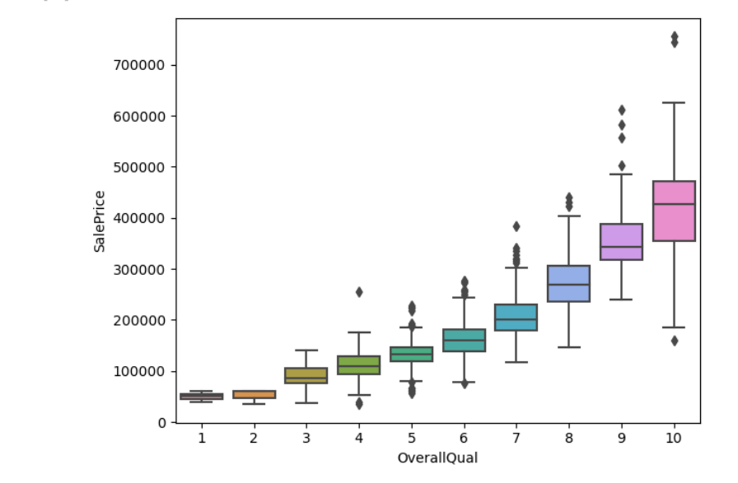
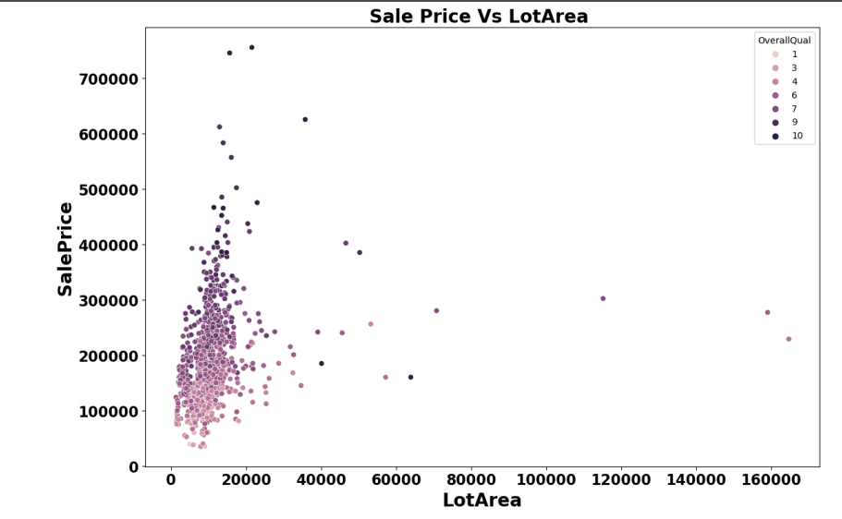
There is No Significant relationship found between Sale price & Lot area.
Most houses fall under 40000 sqft. and the price varies based on overall quality

Slide 15
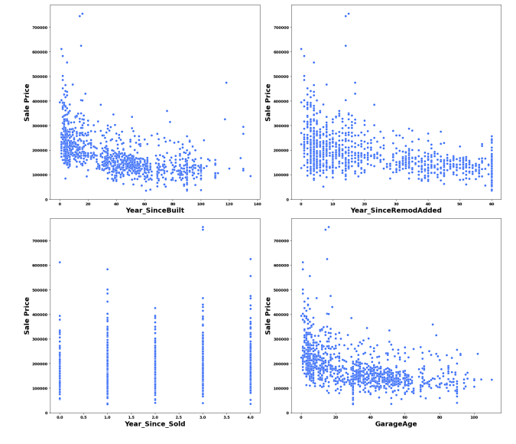
We can see that as Property get older with time its sale Price get depreciated.
20 years after Remodeling Price of properties start decreases.
Older the garage age lesser the price of Property.

Slide 16
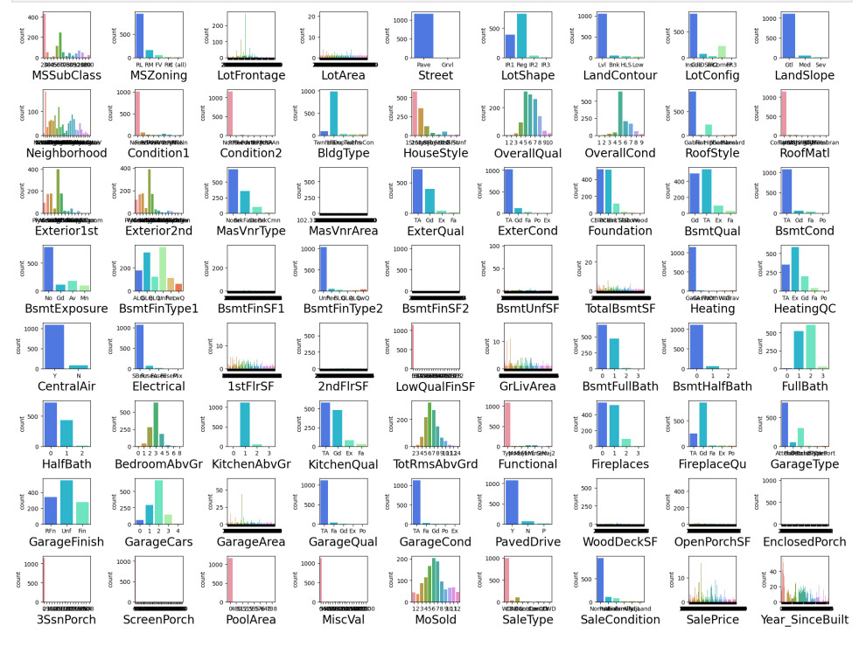

Slide 17
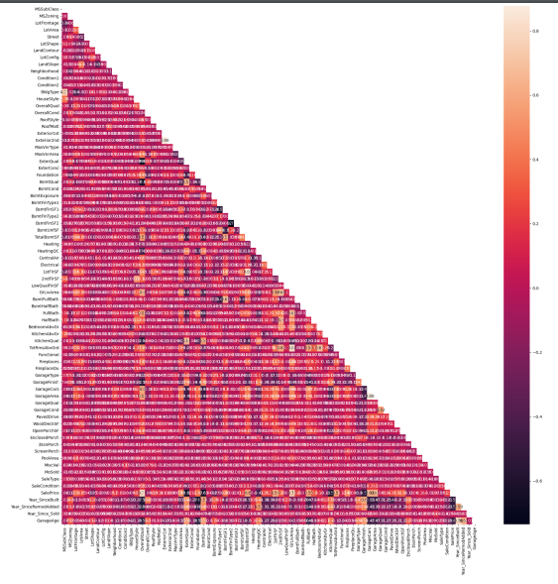
Multicollinearity
There are multicollinearity problem present in our dataset.
Most of the columns are correlated with each other.
Highly collinear columns have been removed.
Still a lot of columns relates with each other and impacts output for each other.

Slide 18
Model Dashboard
lr=LinearRegression()
lasso=linear_model.Lasso()
svr=SVR()
dtr=DecisionTreeRegressor()
rfr=RandomForestRegressor()
Output for each model has been provided in the following slides.

Slide 19
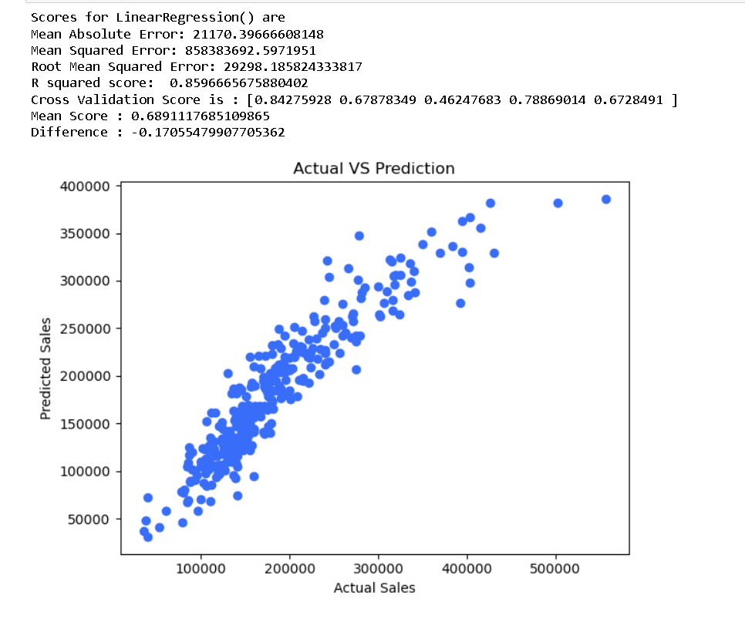
Linear Regression

Slide 20
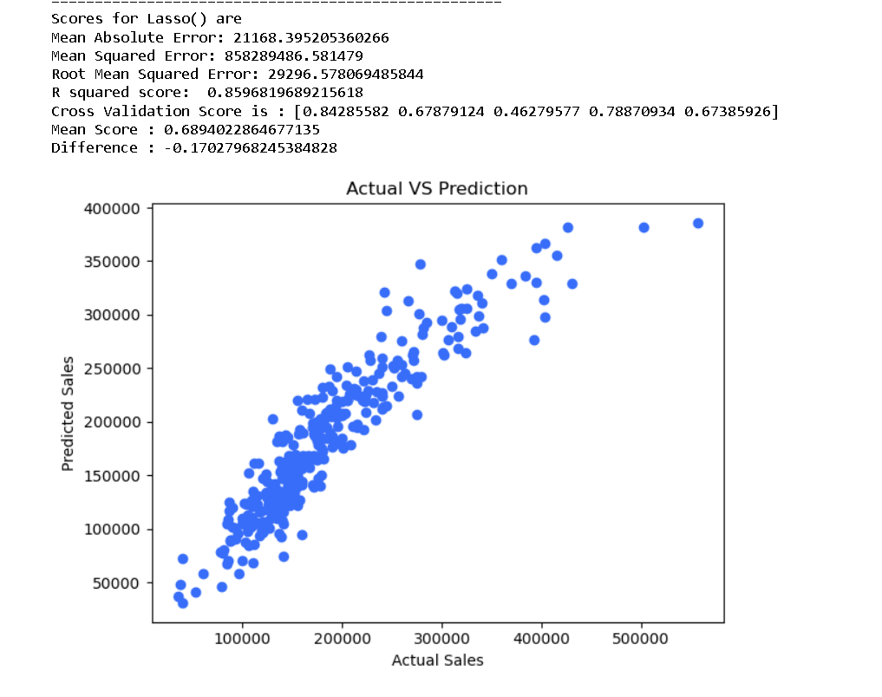
Lasso Regression

Slide 21
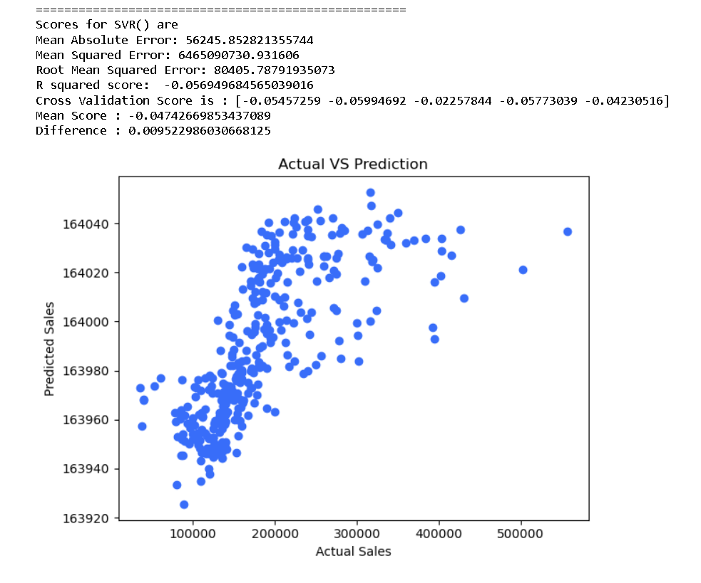
SVR

Slide 22
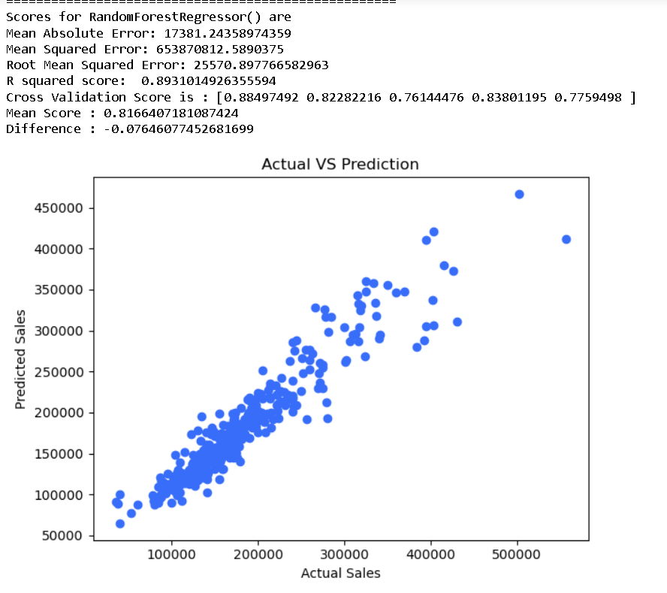
Random Forest Regression

Slide 23
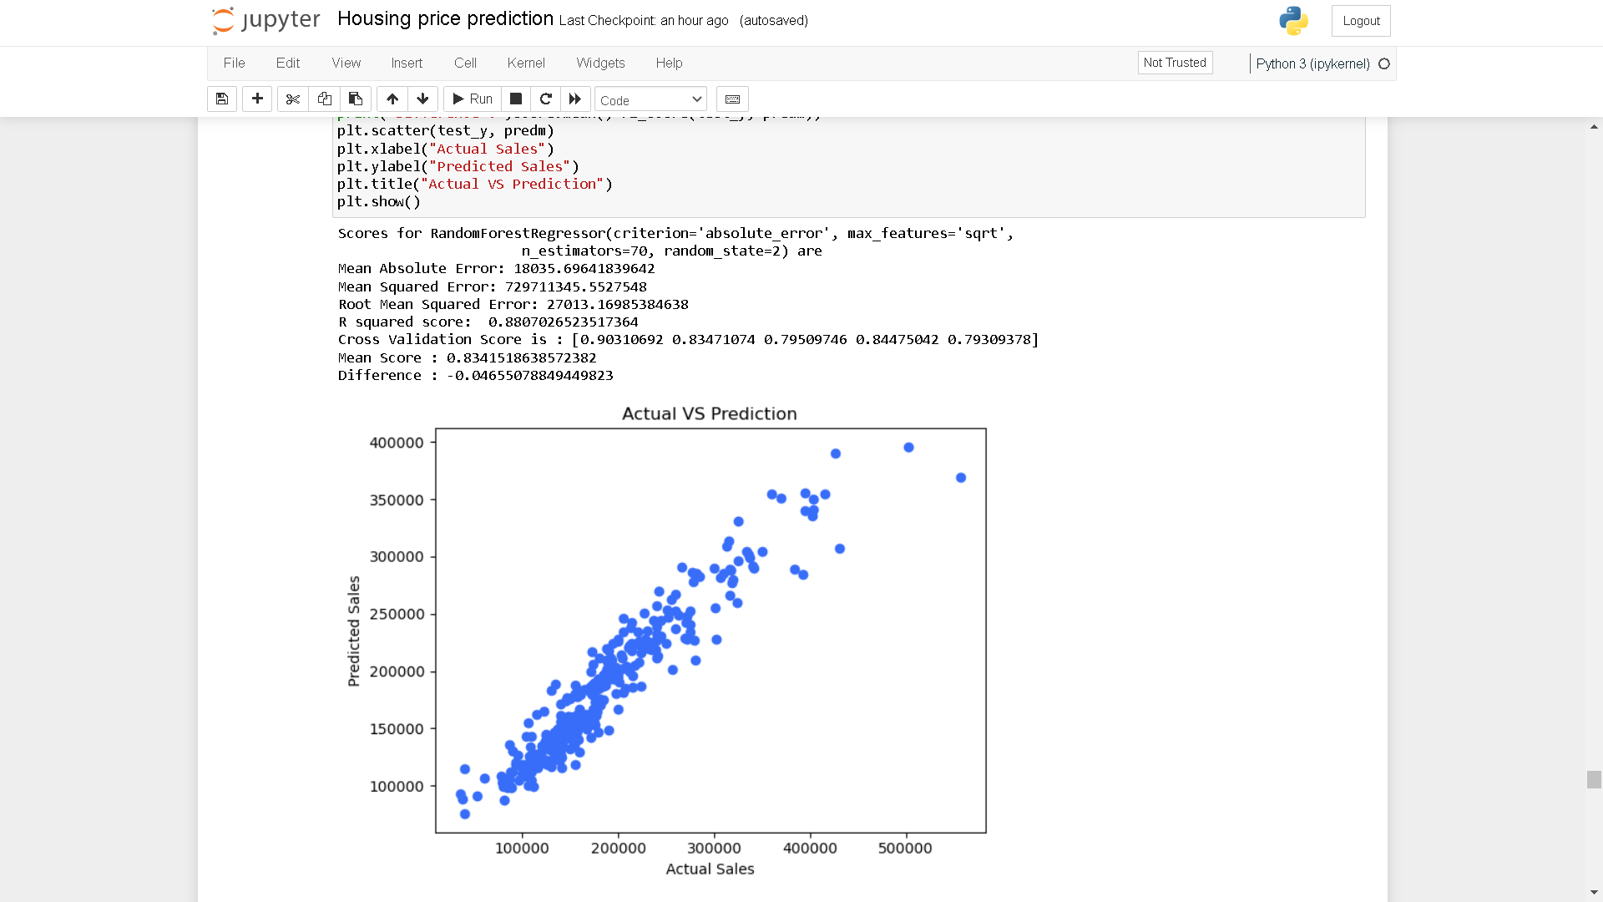
Random Forest Regression with Hyper-tuning
This gives the best output so this is the finalized model.

Slide 24
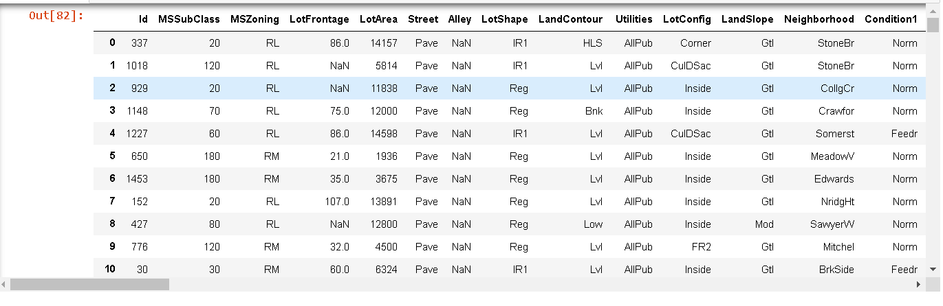
Predictive Statistic:
Test Dataset:
Tweaked the test dataset according to train dataset so that it can fit the model.

Slide 25
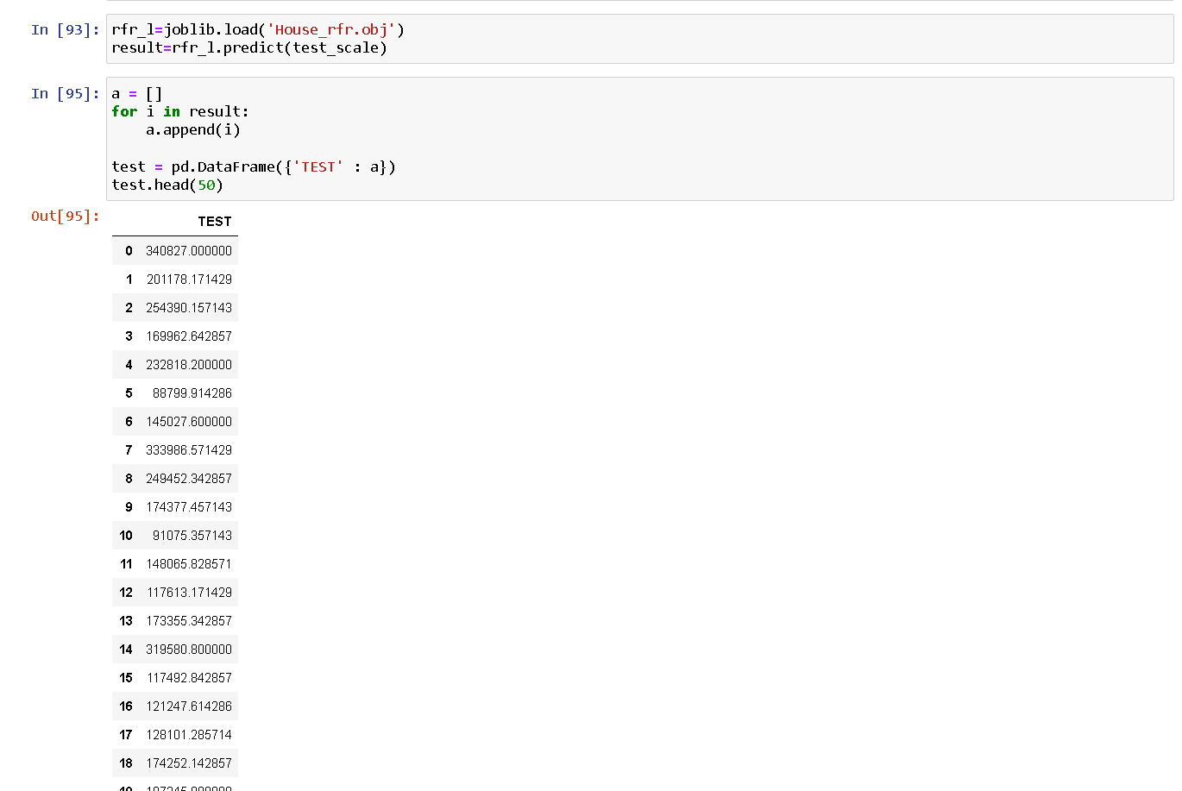
Result of the test dataset provided using the random forest regression model.

